Slide 1
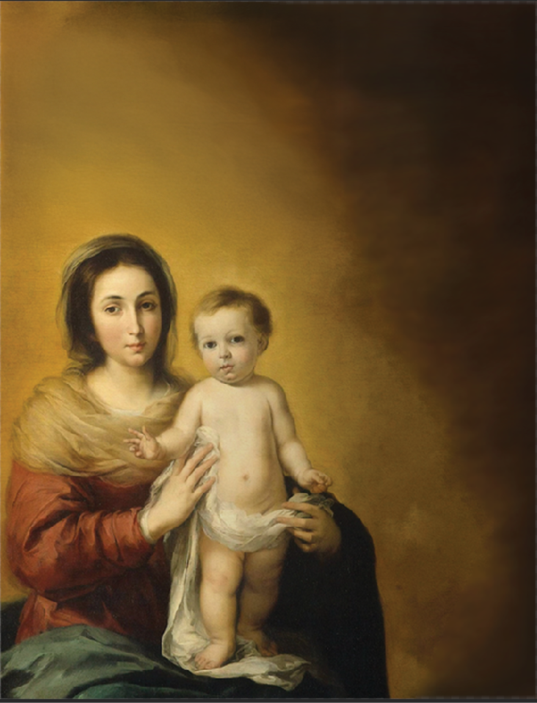
Eucharistic
Rosary
Congress
October 4 – 10, 2025
SATURDAY, OCTOBER 4, 2025
St. Mary Church, Location
(999) 999-9999
7:00 p.m. Opening Mass
Followed by Adoration
SUNDAY, OCTOBER 5, 2025
St. Joseph Church, Location
(999) 999-9999
7:00 p.m. Opening Mass
Followed by Adoration
“My Soul Magnifies the Lord”
MONDAY, OCTOBER 6, 2025
St. Juan Diego Church, Location
(999) 999-9999
7:00 p.m. Opening Mass
Followed by Adoration
TUESDAY, OCTOBER 7, 2025
St. Alphonsus Church, Location
(999) 999-9999
7:00 p.m. Opening Mass
Followed by Adoration
WEDNESDAY, OCTOBER 8, 2025
St. Padre Pio Church, Location
(999) 999-9999
7:00 p.m. Opening Mass
Followed by Adoration
THURSDAY, OCTOBER 9, 2025
St. Leo Church, Location
(999) 999-9999
7:00 p.m. Opening Mass
Followed by Adoration
FRIDAY, OCTOBER 10, 2025
St. Mary Church, Location
(999) 999-9999
7 p.m. Closing Mass
TO SIGN UP FOR AN HOUR:
Email:
Phone:
Web Address:

