Slide 1
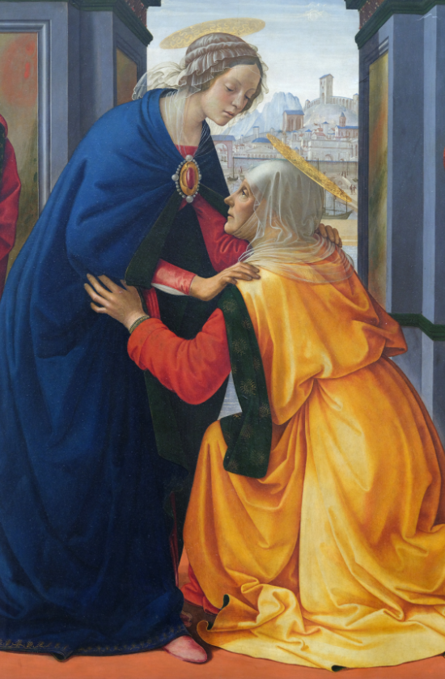
“My Soul Magnifies the Lord”
Eucharistic Rosary Congress
St. Joseph Church
In the Archdiocese of New York
October 4 – 10, 2025
St. Joseph Roman Catholic Church
16 Poplar Avenue
Staten Island, NY 10309
[Schedule example]
Saturday, October 4
6 pm Opening Mass
Followed by one week of Perpetual Adoration and hourly Rosary
Friday, October 10
6 pm Closing Mass
October 5-10
9AM Daily Mass
Sign up for an hour at:
https:
or just show up!
For more information email [name] at:
[name@email].com

Slide 2
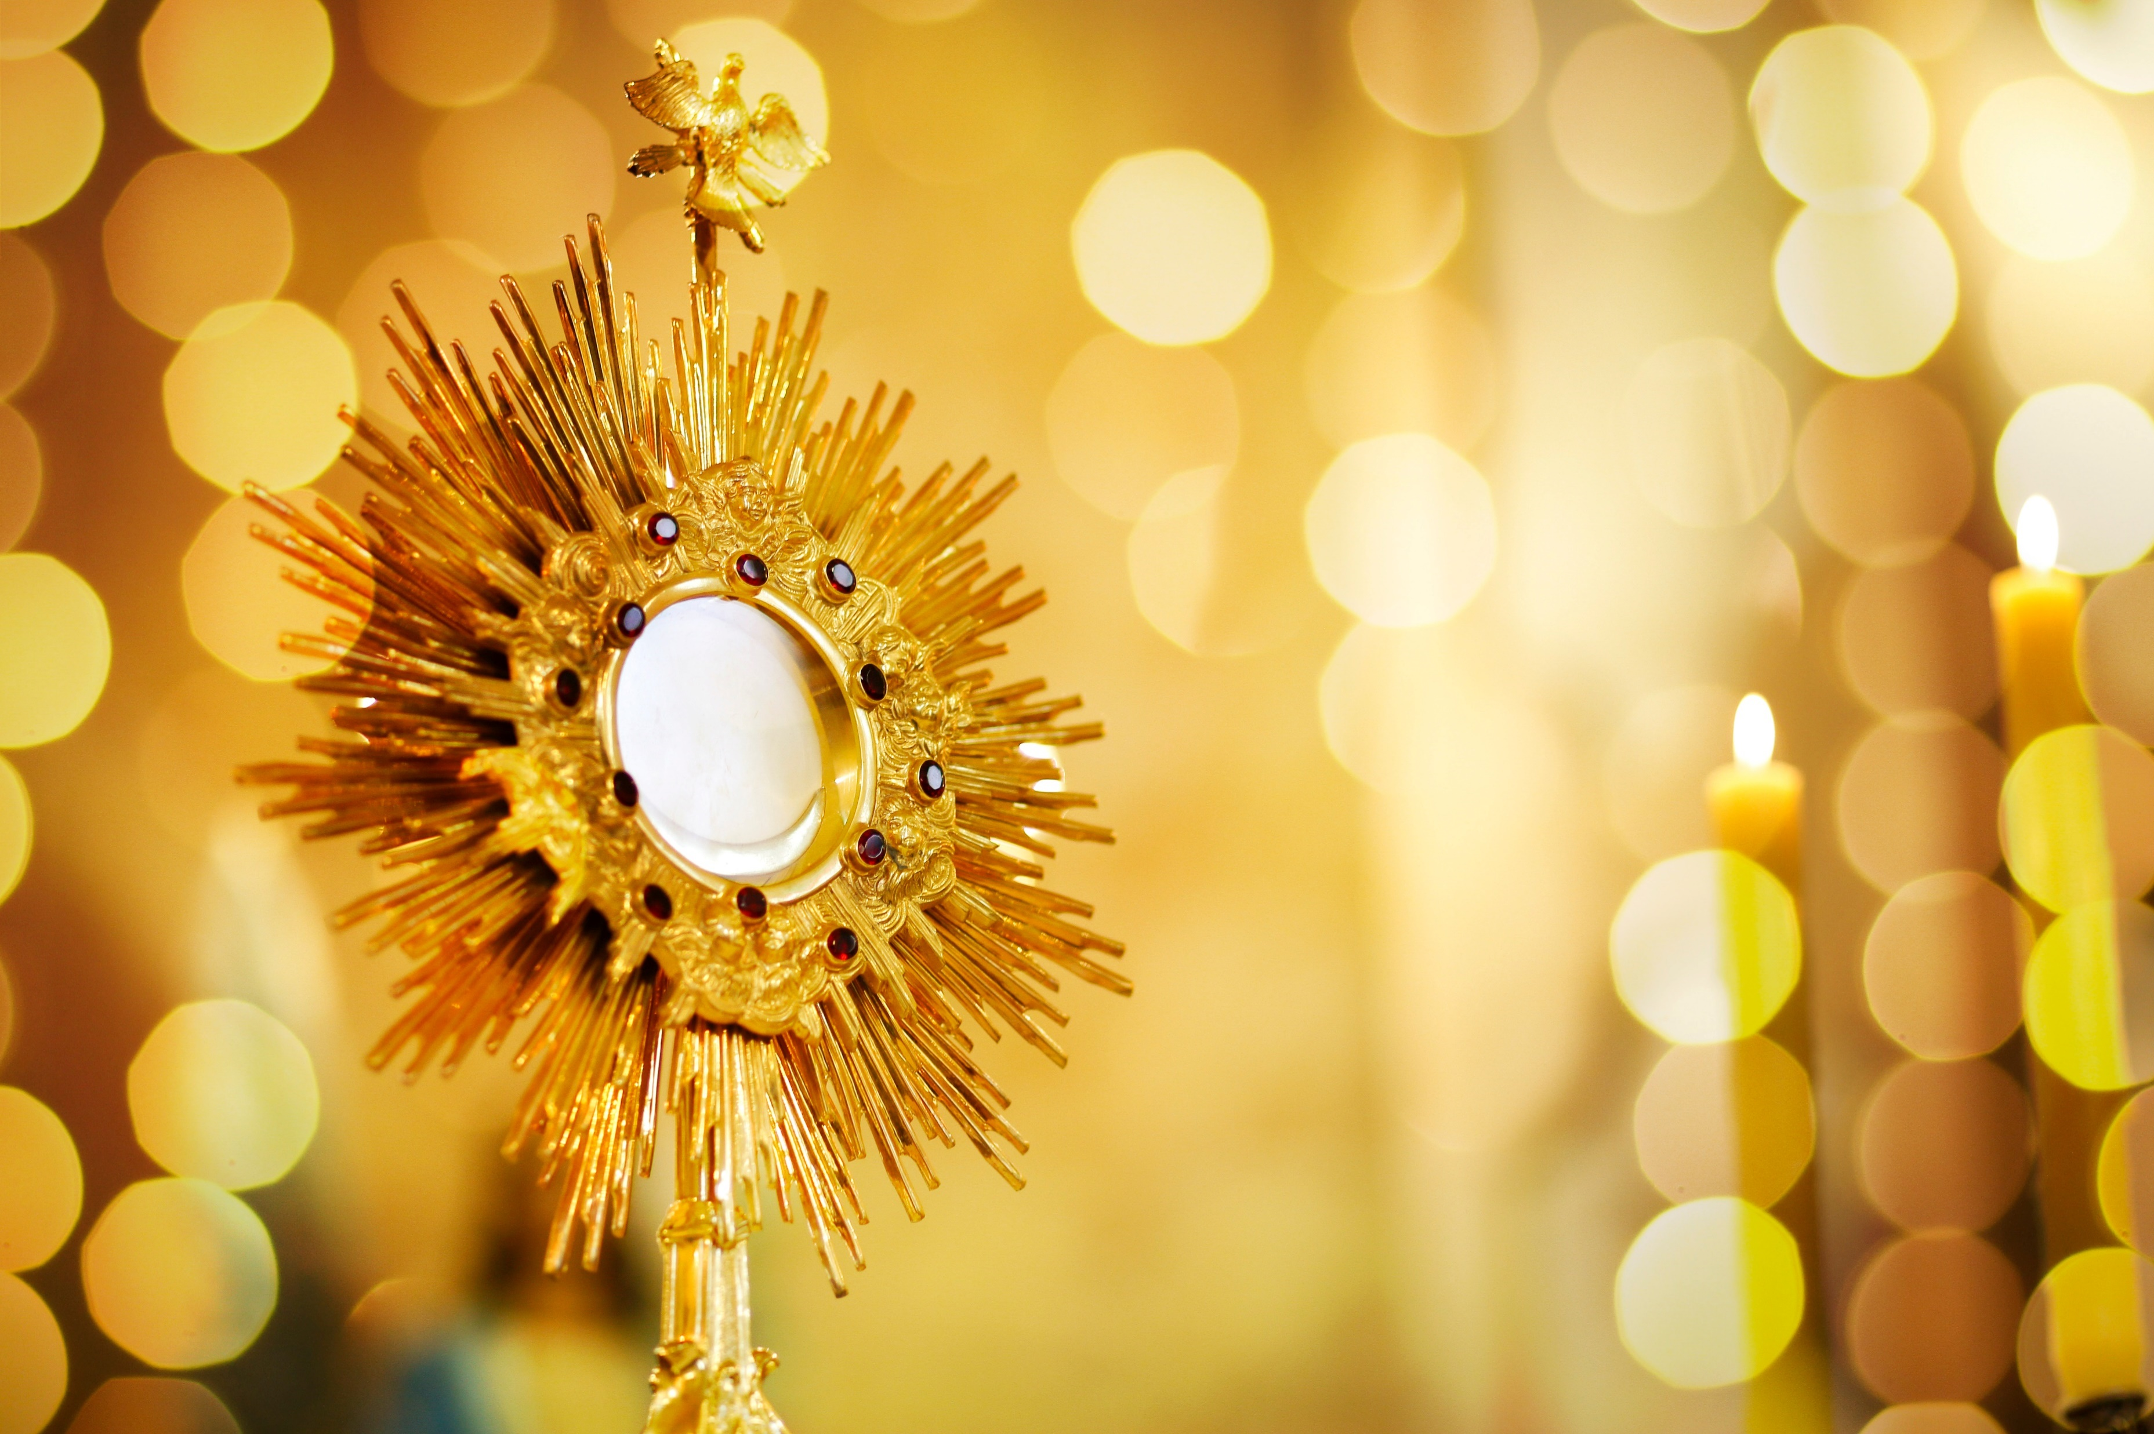

“My Soul Magnifies the Lord”
Eucharistic Rosary Congress
October 4 – 10, 2025
Eucharistic Adoration
(provide details here about Eucharistic Adoration at your congress)
Holy Rosary – Every hour on the hour
Participants are encouraged to pray the rosary aloud at the beginning of the hour. A Rosary Binder with the prayers is provided.
Special Events
If you plan on hosting a speaker or many, list any details here, including the schedule and a picture/bio of the speaker(s). Otherwise, you can list any other special events you plan on hosting, or other information attendees should know.
Also list when your host parish has Daily Mass, if applicable
[Location]
Date/Time Range, such as:
October 4 6 pm Mass –
October 10 6 Pm Mass
123 Example Street
City, ST 12345
Sign Up for an Hour:
or just show up!
Provide information on how to sign up here, such as a website or phone number

