Slide 1
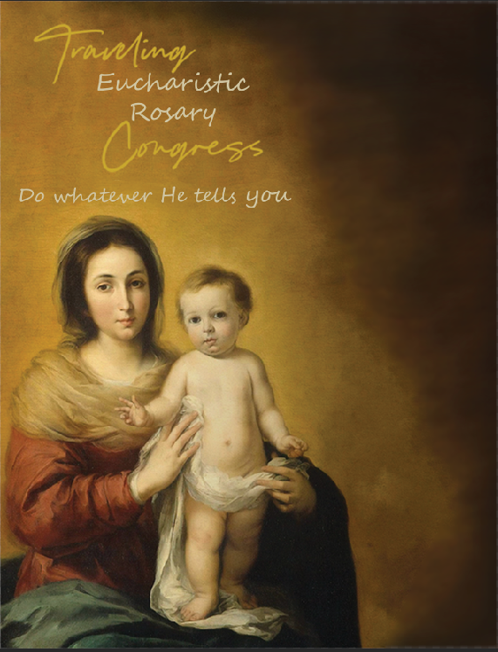
SATURDAY, OCTOBER 5, 2024
St. Mary Church, Location
(999) 999-9999
7:00 p.m. Opening Mass
Followed by Adoration
SUNDAY, OCTOBER 6, 2024
St. Joseph Church, Location
(999) 999-9999
7:00 p.m. Opening Mass
Followed by Adoration
MONDAY, OCTOBER 7, 2024
St. Juan Diego Church, Location
(999) 999-9999
7:00 p.m. Opening Mass
Followed by Adoration
TUESDAY, OCTOBER 8, 2024
St. Alphonsus Church, Location
(999) 999-9999
7:00 p.m. Opening Mass
Followed by Adoration
WEDNESDAY, OCTOBER 9, 2024
St. Padre Pio Church, Location
(999) 999-9999
7:00 p.m. Opening Mass
Followed by Adoration
THURSDAY, OCTOBER 10, 2024
St. Leo Church, Location
(999) 999-9999
7:00 p.m. Opening Mass
Followed by Adoration
FRIDAY, OCTOBER 11, 2024
St. Mary Church, Location
(999) 999-9999
7 p.m. Closing Mass
TO SIGN UP FOR AN HOUR:
Email:
Phone:
Web Address:

